Slide 1
SERRANO WATER DISTRICT 2026 WATER RATE STUDY
Board Meeting – March 19, 2026

Slide 2
Agenda
Rate study overview
Schedule
Proposed results
Discussion & next steps

Slide 3
Rate Study Process
Policy Framework
Cost-of-Service Analysis
Rate Design
Documentation
Financial Plan
Identify Key Policy Objectives (Revenue Stability, Customer Affordability, etc.)
What are our priorities and values?
Develop Multi-year Cash Flow Projections to Determine Annual Rate Revenue Requirement
How much revenue do we need?
Allocate the Rate Revenue Requirement to Customers in Proportion to Use of and Burden on the Water System
Who should pay for what?
Identify Appropriate Rate Structure Changes and Calculate Proposed Rates
What are the impacts of the proposed rates?
Develop a Study Report to Provide Transparency and Defensibility
Is there documentation showing that rates
are proportional?

Slide 4

Proposition 218 (Article XIIIC and XIIID of California Constitution)
Applies to Property-related Fees for Service Including Retail Water Rates
Rate Implications:
Rates must be proportional to and may not exceed the cost of providing service
One customer class (residential, commercial, etc.) may not subsidize another customer class
Retail agencies typically conduct a “cost-of-service analysis” at least once every 5 years to ensure a sufficient nexus between rates and costs
Procedural Requirements

Slide 5
Proposition 218
Due to a Series of Court Rulings on Water Rates
Water and Wastewater is a Property-Related Service
Rates Need to be Proportional to the Level of Service
This is the nexus requirement.
Administrative Record is Required to Document the Rationality and Calculation of the Rates
We need to show the math behind our work.
“Demonstrate the Cost Basis” per the San Juan Capistrano decision.
Implications
Business Model of Operating the Utility Should be Reflected in the Rate Structure
We Cannot Have Rates that Subsidize Certain Customers

Slide 6

Recent Proposition 218 Litigation
Implications:
Higher Burden of Proof to Show that Rates are Proportional to Costs
Rates Primarily Designed to Promote Water Efficiency/Conservation, Even When Compliant with Industry Standards, May Not Meet Prop 218 Requirements
Tiered Rates Require a Higher Level of Justification and Are Vulnerable to Legal Challenges
Higher Degree of Uncertainty Regarding Which Rate Structures Will Pass Legal Muster
Recent Court Judgements
JULY 2024: Cozairh v. Otay Water District Ruling
JULY 2025: Patz v. City of San Diego
DEC. 2025: Dreher v. City of Los Angeles Department of Water and Power

Slide 7
Rate Study Report
Demonstrates proportionality between costs & rates
Provides transparency to the public
Critical part of administrative record in event of legal challenge

Slide 8
Rate Study Goal
Currently adopted five-year rate schedule:
Spans FY 2021/22 - FY 2025/26
The final year of adopted rate increases was not implemented in FY 2025/26
Rates have remained unchanged since July 2024
2025 Water Rate Study:
Goal: Develop a proposed five-year rate schedule for FY 2026/27 - FY 2030/31 that:
Meets Prop 218 legal requirements
Meets the District’s funding needs
Is consistent with industry standards established by AWWA

Slide 9
Schedule
Board to receive rate study report today
Mail out public hearing notices to all customers by March 27th
Rate study workshop at 5pm on May 14th
Public hearing to adopt rates at 5pm on May 27th
New rates effective July 1st

Slide 10
Financial Plan

Slide 11
Key Financial Plan Assumptions: CIP
New well 100% funded by OCWD loan
$26M of Smith Reservoir costs assumed to funded by new bond issue
CIP Projects | FY 2026 | FY 2027 | FY 2028 | FY 2029 | FY 2030 | FY 2031 | Total
New Well | $800,000 | $7,200,000 | $0 | $0 | $0 | $0 | $8,000,000
Smith Reservoir | $0 | $13,500,000 | $13,500,000 | $0 | $0 | $0 | $27,000,000
Lockett Reservoir Coating & Corrosion | $0 | $0 | $2,000,000 | $0 | $0 | $0 | $2,000,000
Main Line Replacement | $500,000 | $2,000,000 | $2,060,000 | $2,121,800 | $2,185,454 | $2,251,018 | $11,118,272
Misc. Capital Replacements | $140,000 | $200,000 | $206,000 | $212,180 | $218,545 | $225,102 | $1,201,827
Total | $1,440,000 | $22,900,000 | $17,766,000 | $2,333,980 | $2,403,999 | $2,476,119 | $49,320,099

Slide 12
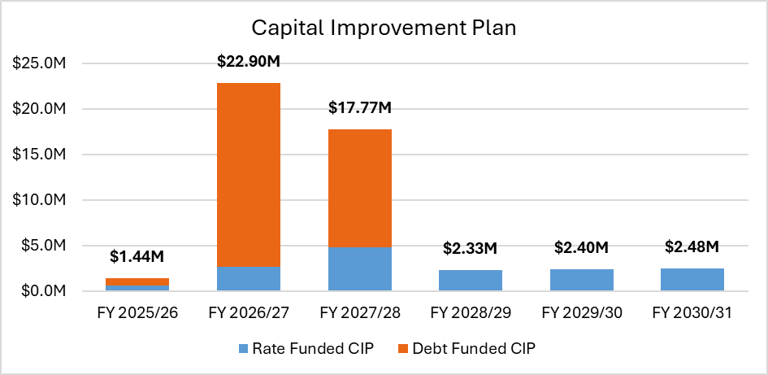
Key Financial Plan Assumptions: CIP Funding

Slide 13
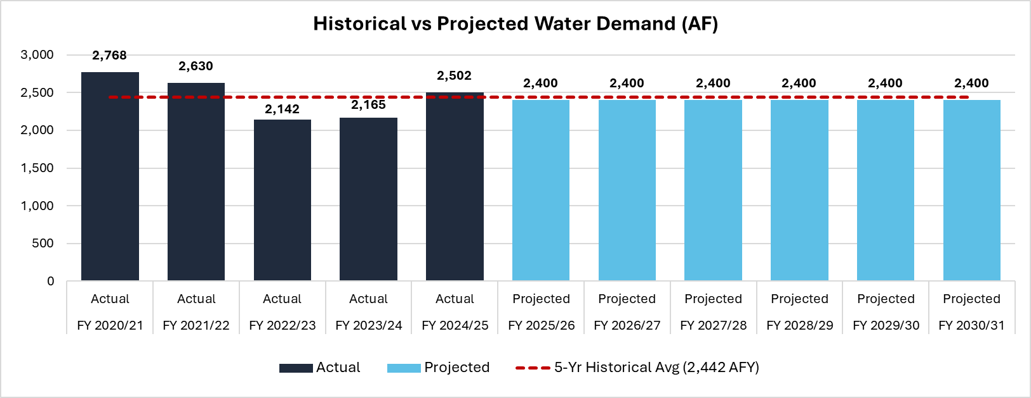
Key Financial Plan Assumptions: Water Demand
Customer water demand projected to remain constant at 2,400 acre-feet per year (about 1.7% below 5-year historical average)

Slide 14
Reserve Policy
Reserve | Minimum Reserve Level (~$4.2M Total) | Target Reserve Level (~$6.8M Total)
Operating Reserve | 6 months of operating expenses | 6 months of operating expenses
Capital Project Reserve | Annual depreciation | Annual average of 10-year CIP
Emergency Reserve | 5% of capital assets net of depreciation | $1.5 million

Slide 15
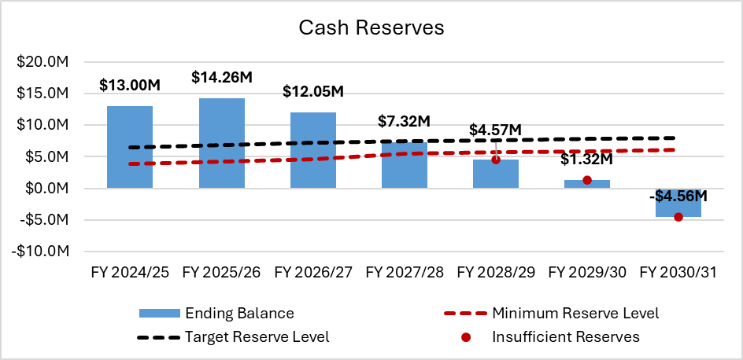
Status Quo Financial Plan (NO REVENUE ADJUSTMENTS)
Fiscal Year | Effective Month | Revenue Adjustment
FY 2026/27 | July 2026 | 0%
FY 2027/28 | July 2027 | 0%
FY 2028/29 | July 2028 | 0%
FY 2029/30 | July 2029 | 0%
FY 2030/31 | July 2030 | 0%

Slide 16
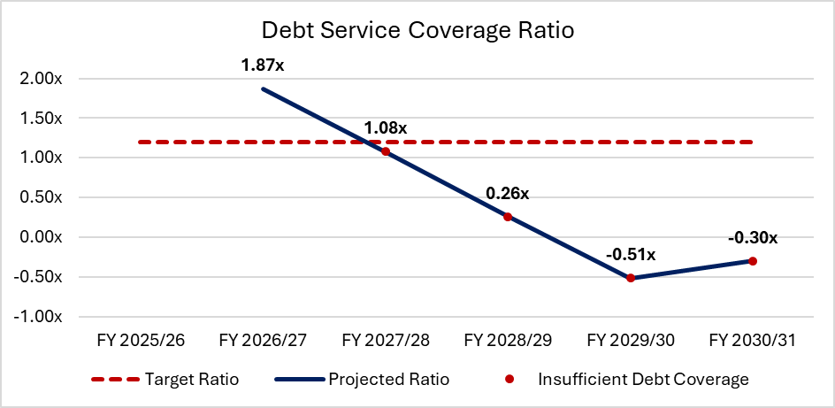
Status Quo Financial Plan (NO REVENUE ADJUSTMENTS)
Fiscal Year | Effective Month | Revenue Adjustment
FY 2026/27 | July 2026 | 0%
FY 2027/28 | July 2027 | 0%
FY 2028/29 | July 2028 | 0%
FY 2029/30 | July 2029 | 0%
FY 2030/31 | July 2030 | 0%

Slide 17
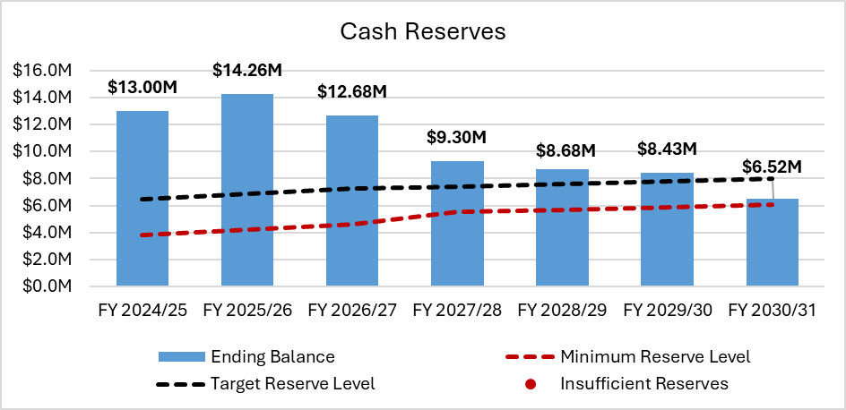
Proposed Financial Plan (9% REVENUE ADJUSTMENTS)
Fiscal Year | Effective Month | Revenue Adjustment
FY 2026/27 | July 2026 | 9%
FY 2027/28 | July 2027 | 9%
FY 2028/29 | July 2028 | 9%
FY 2029/30 | July 2029 | 9%
FY 2030/31 | July 2030 | 9%

Slide 18
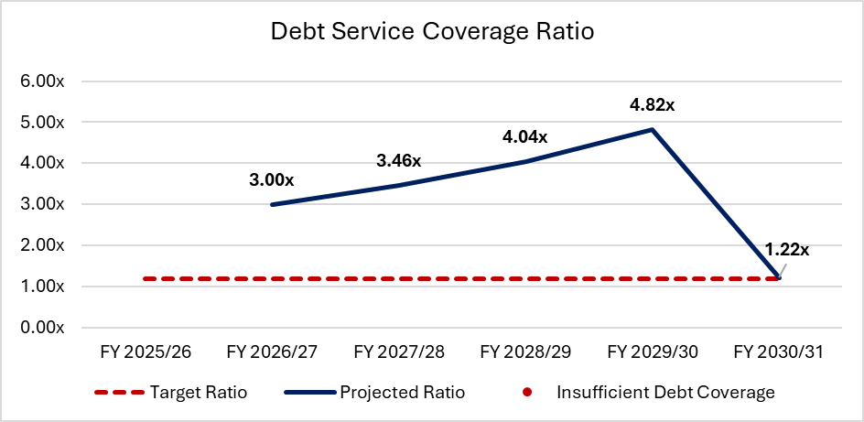
Proposed Financial Plan (9% REVENUE ADJUSTMENTS)
Fiscal Year | Effective Month | Revenue Adjustment
FY 2026/27 | July 2026 | 9%
FY 2027/28 | July 2027 | 9%
FY 2028/29 | July 2028 | 9%
FY 2029/30 | July 2029 | 9%
FY 2030/31 | July 2030 | 9%

Slide 19
Preliminary Rates

Slide 20
Current Rate Structure
No proposed changes to current rate structure:
1) Fixed Readiness to Serve Charge
Increases with meter size
2) Volumetric rate per unit of water delivered
Volumetric rate starts when water use exceeds 1 unit
Current Water Rates | Effective July 1, 2024
Readiness to Serve Charge (monthly)
1-inch and under | $45.23
1.5-inch | $50.12
2-inch | $54.94
3-inch | $64.61
4-inch | $74.32
6-inch | $132.33
Volumetric Rate (per HCF)*
All water use exceeding one HCF per month | $5.58
*HCF = one hundred cubic feet = 748 gallons

Slide 21
Pass-Through Provision
We recommend adopting a pass-through provision so that rates can be automatically adjusted if actual cost increases exceed the rate study projections:
1) Water supply cost pass-through based on actual cost increases that exceed:
4.5% annual average projected increase in OCWD Replenishment Assessments
7.8% annual average projected increase in MWDOC imported water
2) Inflationary pass-through based on CPI if actual cost increases exceed:
4.6% annual average projected increase in all other O&M expenses

Slide 22
Proposed Readiness to Serve Charges (FY 2026/27)
Distributional impacts in first year due to updated cost-of-service
Fixed charges increase by meter size based on meter capacity
Readiness to Serve Charge (monthly) | Number of Meters | Meter Capacity Ratio | Current Charge (FY 2025/26) | Proposed Charge (FY 2026/27) | Difference ($) | Difference (%)
1-inch and under | 2,297 | 1.00 | $45.23 | $47.72 | $2.49 | 5.5%
1.5-inch | 8 | 2.00 | $50.12 | $74.03 | $23.91 | 47.7%
2-inch | 45 | 3.20 | $54.94 | $105.60 | $50.66 | 92.2%
3-inch | 0 | 6.40 | $64.61 | $189.79 | $125.18 | 193.7%
4-inch | 2 | 10.00 | $74.32 | $284.50 | $210.18 | 282.8%
6-inch | 3 | 20.00 | $132.33 | $547.59 | $415.26 | 313.8%

Slide 23
Proposed Volumetric Rate (FY 2026/27)
Description
Proposed Rate (FY 2026/27)
Operating Component | $4.99
Capital Component | $1.09
Total Rate (per HCF) | $6.08
Rate Comparison (per HCF)
Proposed Rate (FY 2025/26) | $6.08
Current Rate | $5.58
Difference ($) | $0.50
Difference (%) | 9.0%

Slide 24
Proposed Five-Year Rate Schedule
Water Rates | Current | Proposed FY 2026/27 (July 2026) | Proposed FY 2027/28 (July 2027) | Proposed FY 2028/29 (July 2028) | Proposed FY 2029/30 (July 2029) | Proposed FY 2030/31 (July 2030)
Readiness to Serve Charge (monthly)
1-inch and under | $45.23 | $47.72 | $52.02 | $56.71 | $61.82 | $67.39
1.5-inch | $50.12 | $74.03 | $80.70 | $87.97 | $95.89 | $104.53
2-inch | $54.94 | $105.60 | $115.11 | $125.47 | $136.77 | $149.08
3-inch | $64.61 | $189.79 | $206.88 | $225.50 | $245.80 | $267.93
4-inch | $74.32 | $284.50 | $310.11 | $338.02 | $368.45 | $401.62
6-inch | $132.33 | $547.59 | $596.88 | $650.60 | $709.16 | $772.99
Volumetric Rate (per HCF)
All water use exceeding one HCF per month | $5.58 | $6.08 | $6.63 | $7.23 | $7.89 | $8.61

Slide 25
Customer Bill Impacts

Slide 26
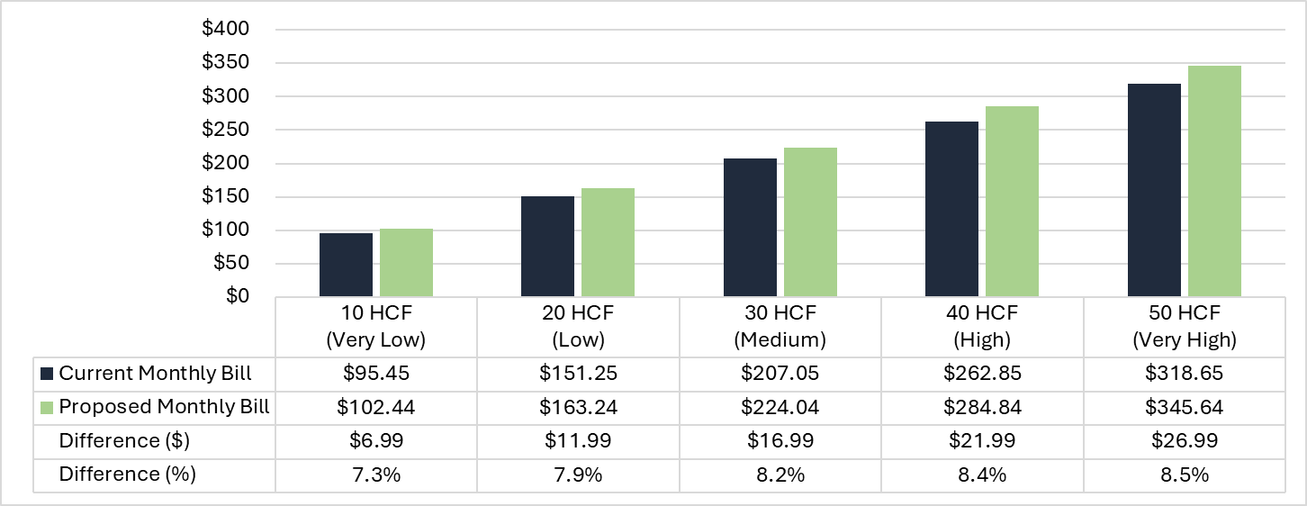
Sample Residential Bills - FY 2026/27
Note: all bills are for a 1-inch or smaller meter

Slide 27
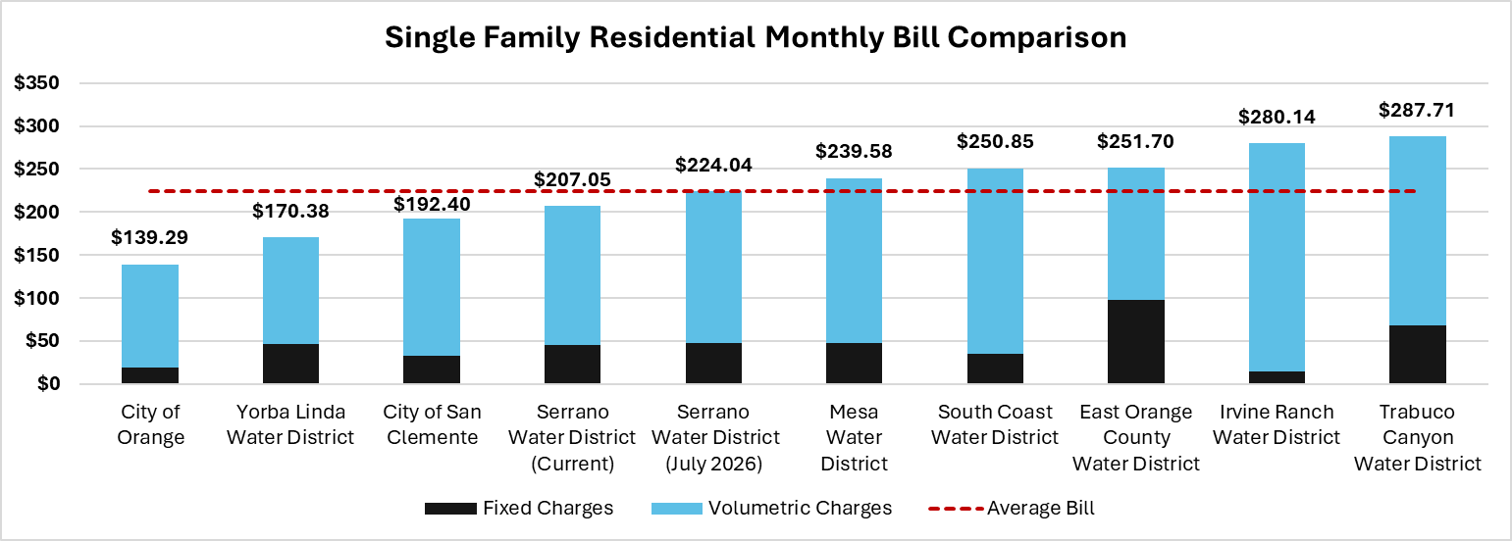
Residential Bill Comparison
Average Bill: $224.31
Note: All bills are for a single family residential customer with the smallest available meter, monthly water use of 30 HCF, and rates effective in March 2026.

Slide 28
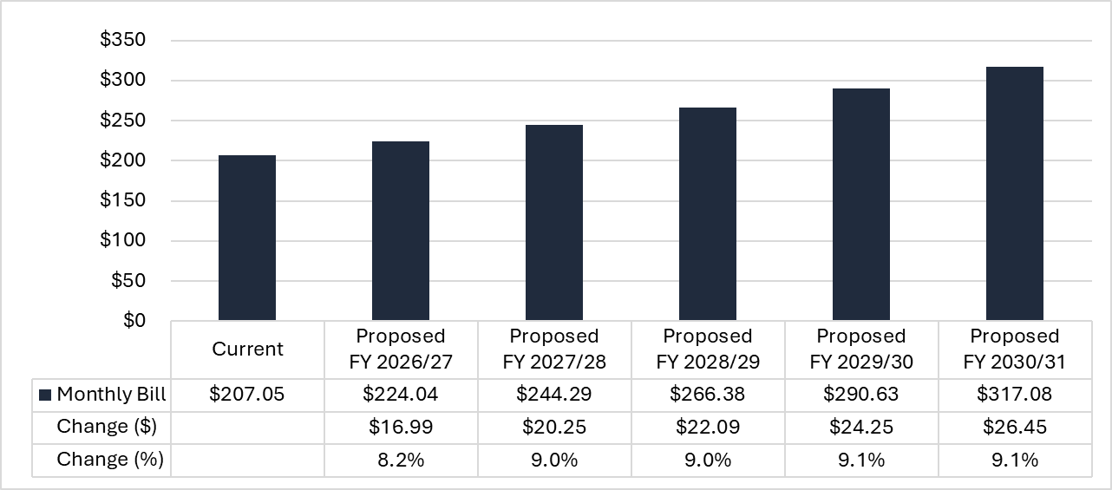
Five Year Bill Impacts for Typical Residential Customer
Note: all bills are for a 1-inch or smaller meter using 30 HCF per month

Slide 29
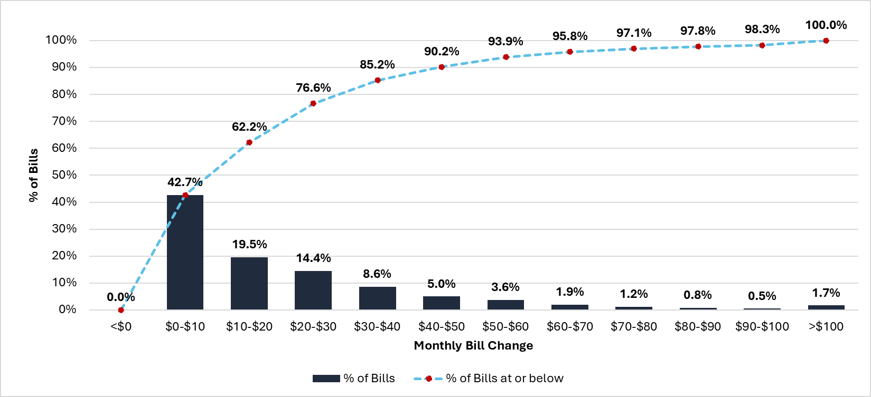
Estimated Monthly Bill Impacts - FY 2026/27
← 62.2% of monthly bills are expected to increase by less than $20

Slide 30
Next Steps
Send out public hearing notices by March 27th
Rate study workshop at 5pm on May 14th
Public hearing to adopt rates at 5pm on May 27th
New rates effective July 1st

Slide 31
Sanjay Gaur
Founder / President
sgaur@water-economics.com

